Slide 1

The Sexiest Job of the 21st Century
by Kevin Rotairo

Slide 2
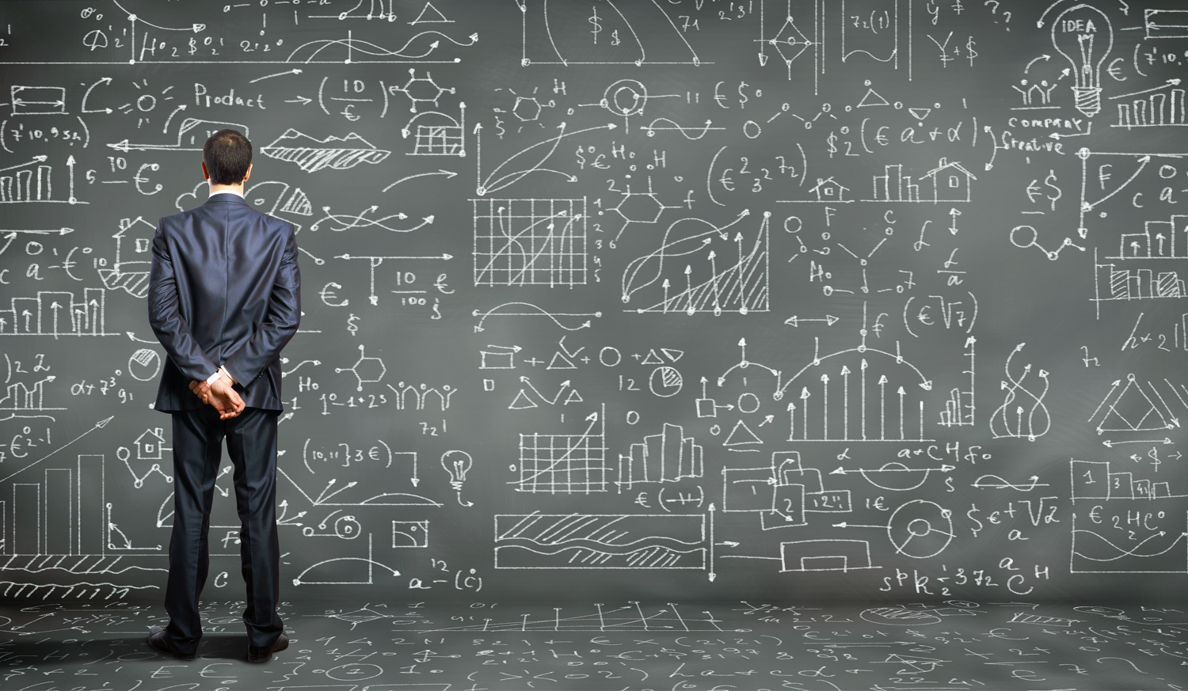
The Sexiest Job of the 21st Century
By:
Kevin Rotairo

Slide 3

Harvard Business Review
https://hbr.org/2012/10/data-scientist-the-sexiest-job-of-the-21st-century

Slide 4

Data Scientists

Slide 5

Topics to discuss
Who is a Data Scientist?
What have Data Scientists achieved?
Definition of Terms
Why do we need Data Scientists?
How to be a Data Scientist?

Slide 6

Definition of Terms

Slide 7

Data Science
Artificial Intelligence
Deep Learning
Machine Learning

Slide 8
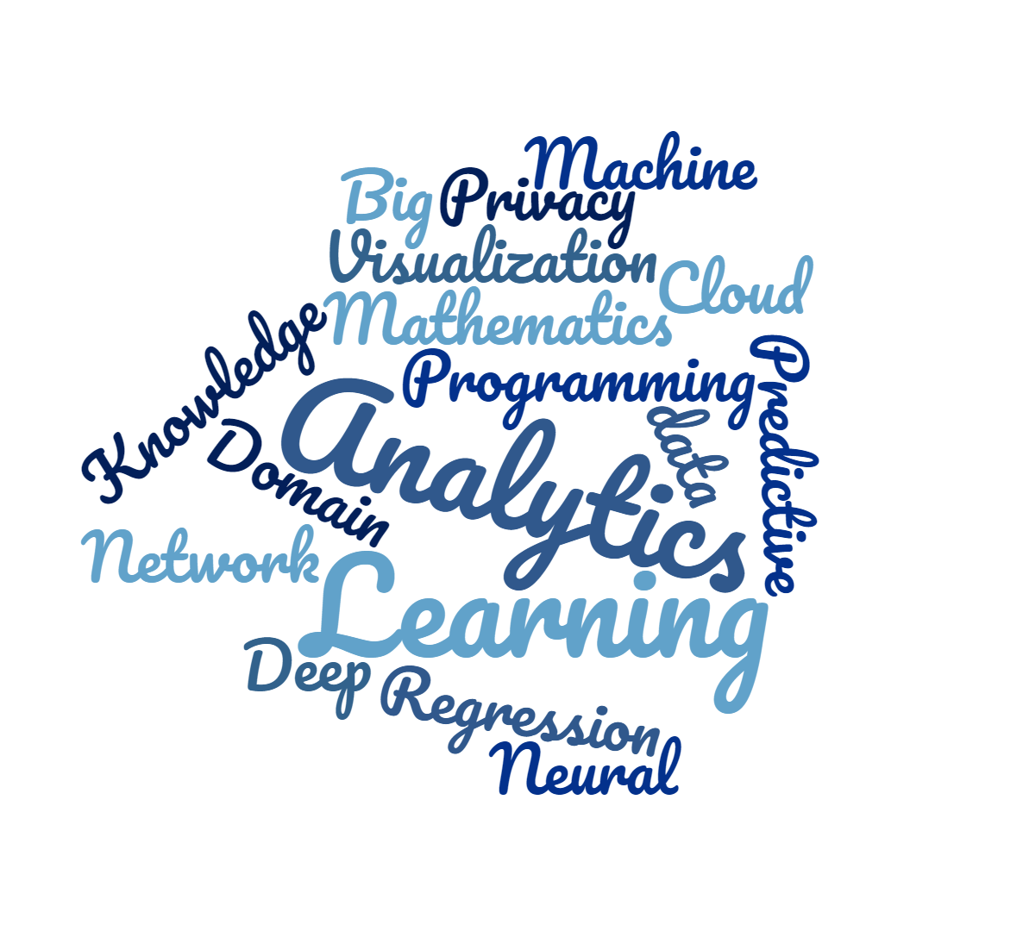
Data
Science

Slide 9

How do you define data?

Slide 10

“Data is the new OIL.” -Clive Humby, UK Mathemetician and architect of Tesco’s Clubcard, 2006
“Data is the new oil.
It’s valuable, but if unrefined it cannot really be used. It has to be changed into gas, plastic, chemicals, etc. to create a valuable entity that drives profitable activity; so must data be broken down, analyzed for it to have value.”

Slide 11

How do you define Science?

Slide 12

the systematic study of the nature and behavior of the material and physical universe, based on observation, experiment, and measurement, and the formulation of laws to describe these facts in general terms (Collins Dictionary) https://www.collinsdictionary.com/dictionary/english/science
Science

Slide 13

Science in Data Science
Multi-disciplinary
Scientific Method
Problem Solving
Formulating Hypotheses
Heuristic Nature

Slide 14

How do you define Artificial Intelligence?

Slide 15
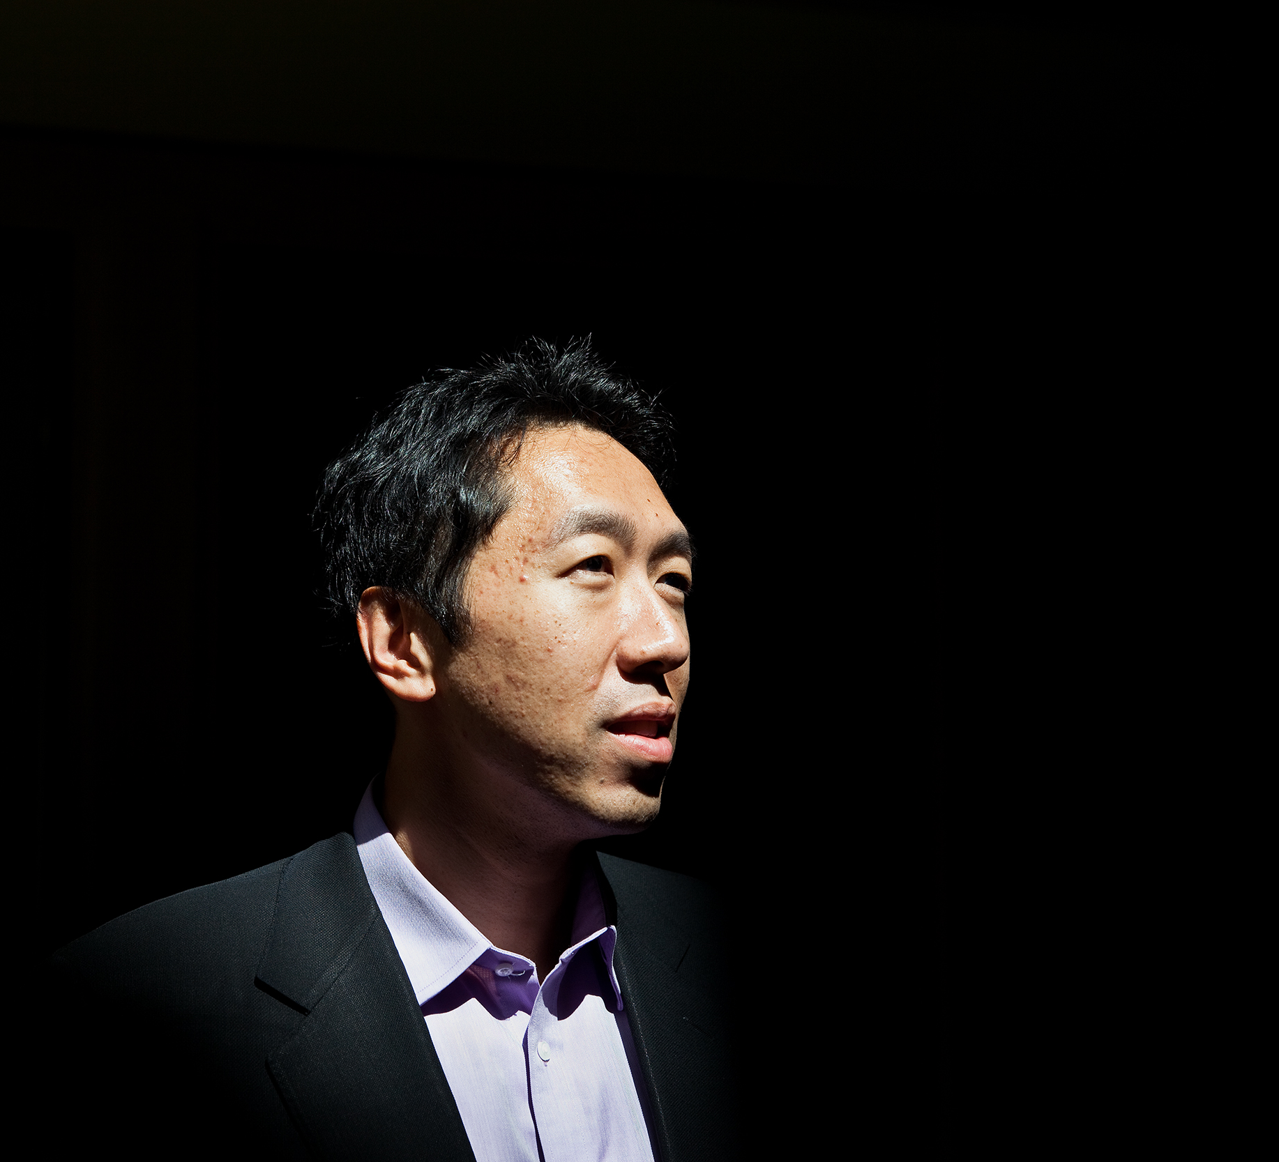
Andrew Ng
“Artificial Intelligence
Is the new Electricity”
Co-founder of Coursera, former Chief Data Scientist of Baidu

Slide 16

How do you define Machine Learning?

Slide 17
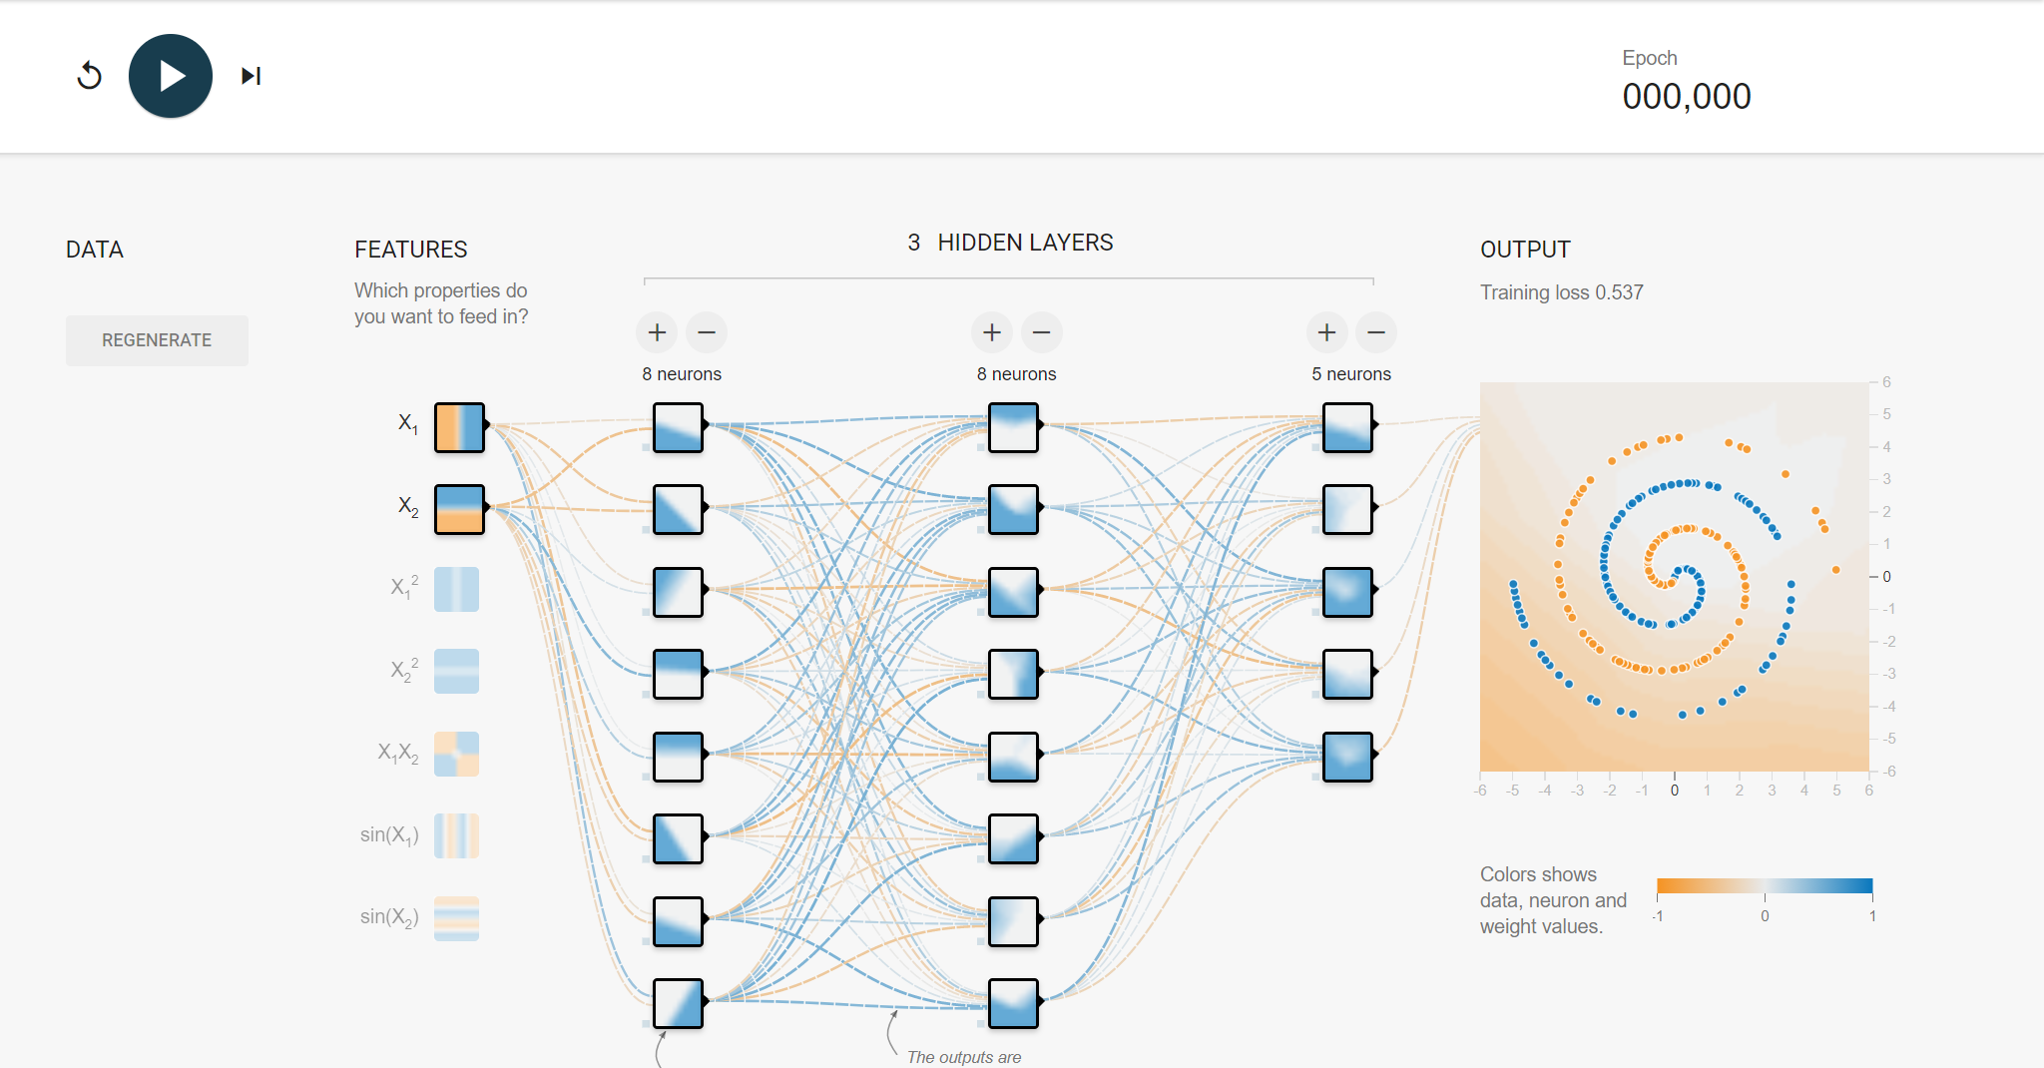
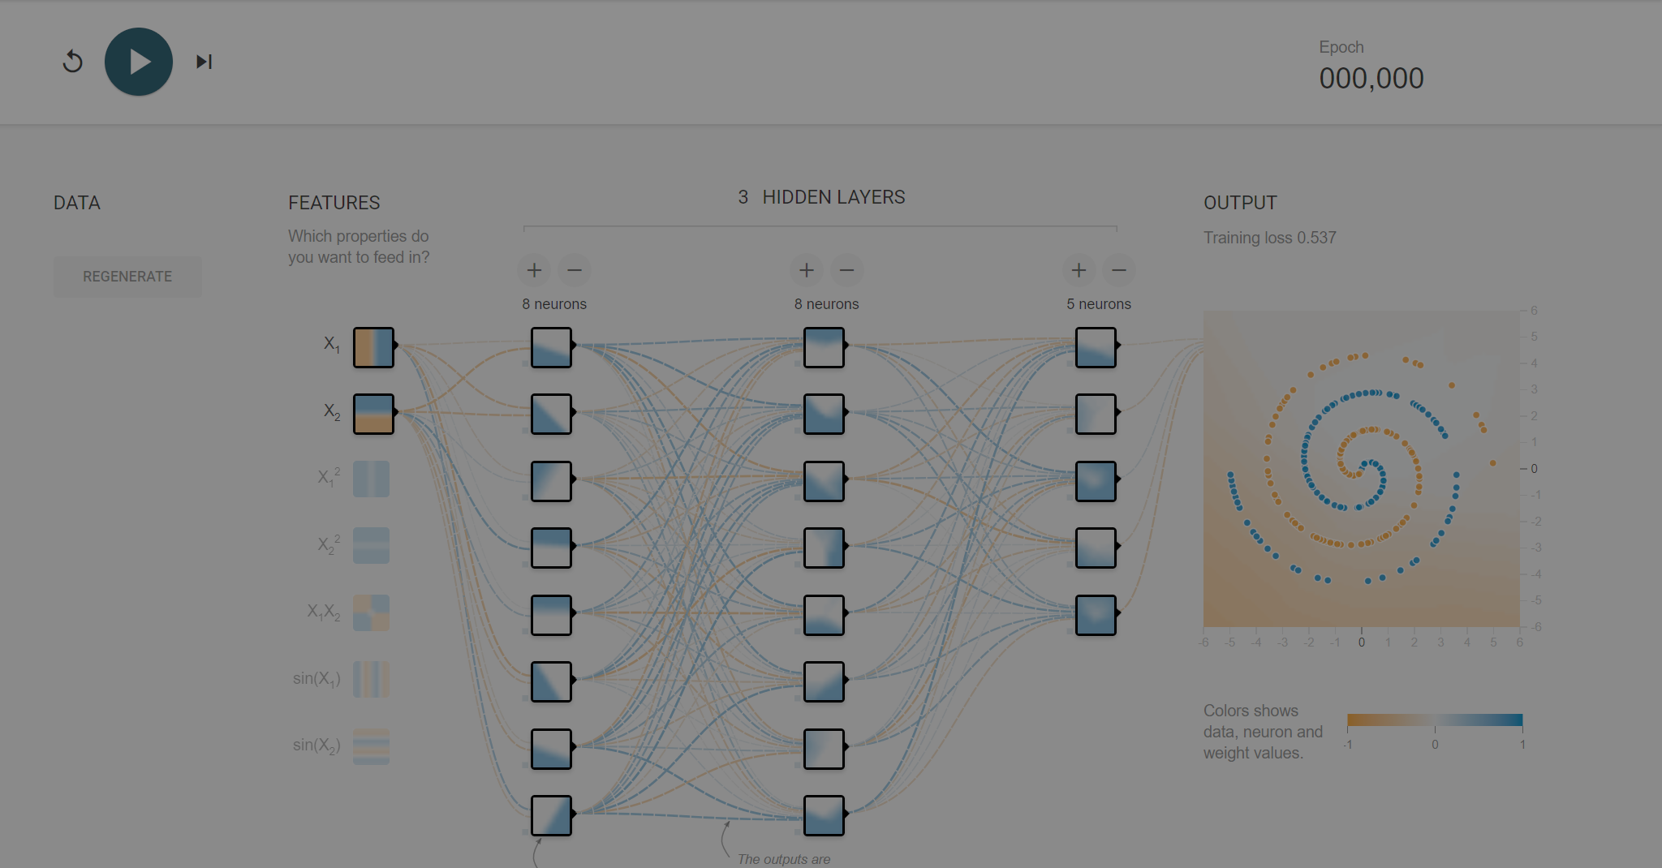

Slide 18


Slide 19


Slide 20


Slide 21


Slide 22


Slide 23


Slide 24
Conventional Software Development
Rules
Programmer
Output

Slide 25
Data Science Process
Data
Learning Algorithm
Output

Slide 26
Why do we need Data Scientists?

Slide 27

With great power comes…
Photo by Muhd Asyraaf on Unsplash

Slide 28


Why now?
Volume
Computation power
https://en.wikipedia.org/wiki/ENIAC

Slide 29
Who is a Data Scientist?

Slide 30


Kevin Rotairo
Data Scientist

Slide 31

Jack of all trades..
Math/ Statistics
Programming
Data Analytics
Visualization and Communication
Domain Knowledge

Slide 32
What have Data Scientists achieved?

Slide 33

What you want your kids to know
Identify things
Music
Arts
Games
Language/Poetry

Slide 34
What you want your kids to know
Identify things
Music
Arts
Games
Language/Poetry

Slide 35

Giorgio Cam

Slide 36
What you want your kids to know
Identify things
Music
Arts
Games
Language/Poetry

Slide 37
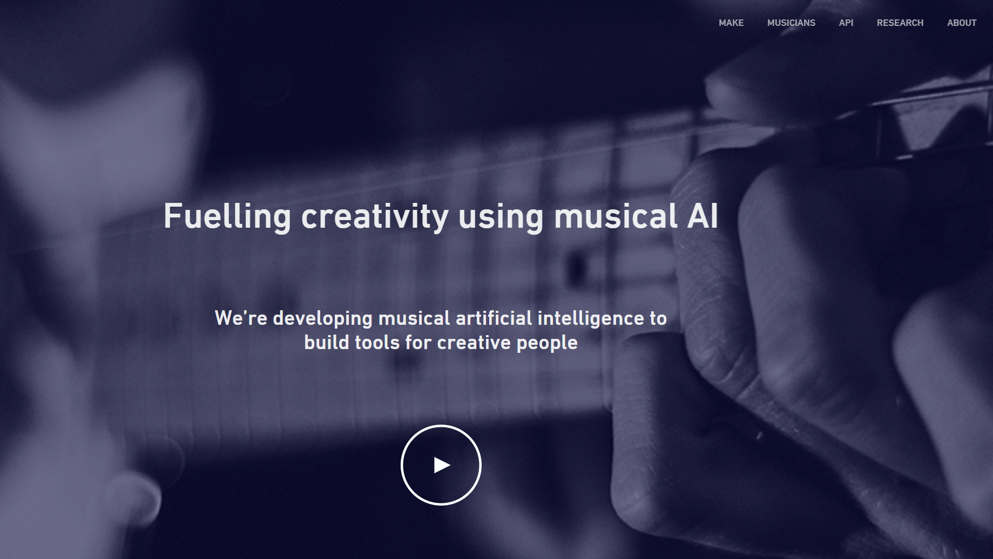
Jukedeck

Slide 38
What you want your kids to know
Identify things
Music
Arts
Games
Language/Poetry

Slide 39
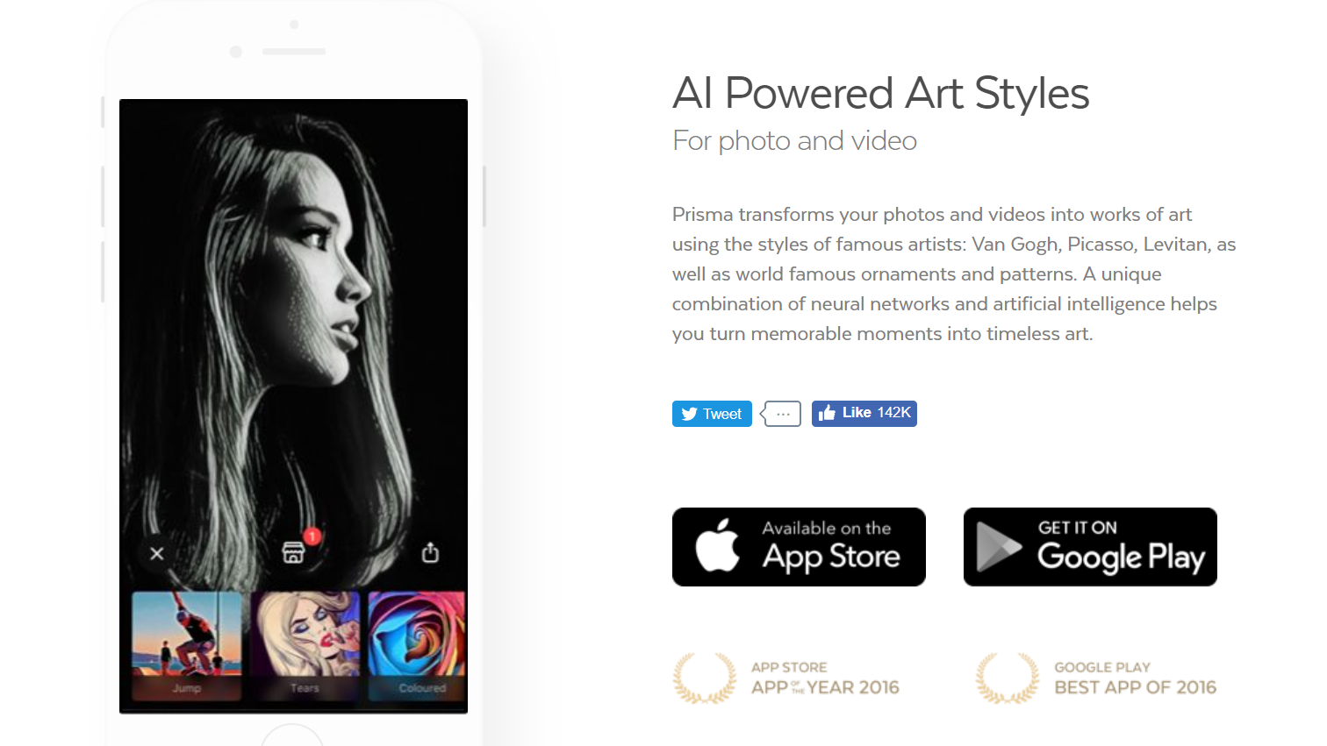
Prisma

Slide 40
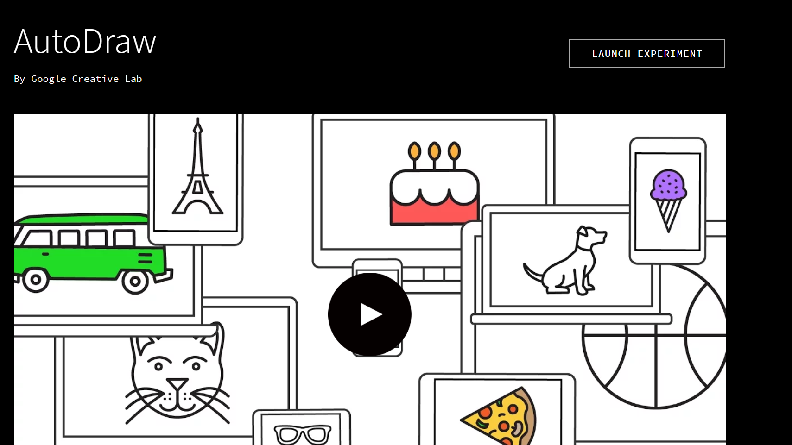
AutoDraw

Slide 41
What you want your kids to know
Identify things
Music
Arts
Games
Language/Poetry

Slide 42
What you want your kids to know
Identify things
Music
Arts
Games
Language/Poetry

Slide 43
How to be a Data Scientist?

